Slide 1
Naplan Yr 9 Stats and Probability review
J.Wilson

Slide 2
Management occupations
Advertising, marketing, promotions, public relations, and sales managers
Computer and information systems managers
Construction managers
Education administrators
Engineering and natural sciences managers
Farmers, ranchers, and agricultural managers
Financial managers
Food service managers
Funeral directors
Human resources, training, and labour relations managers and specialists
Industrial production managers
Lodging managers
Medical and health services managers
Property, real estate, and community association managers
Purchasing managers, buyers, and purchasing agents
Top executives
Business and financial operations occupations
Accountants and auditors
Budget analysts
Financial analysts and personal financial advisors
Insurance underwriters
Loan officers
Management analysts
Healthcare support occupations
Medical assistants
Nursing, psychiatric, and home health aides
Protective service occupations
Firefighting occupations
Police and detectives
Building and grounds cleaning and maintenance occupations
Grounds maintenance workers
Personal care and service occupations
Gaming services occupations
Personal and home care aides
Financial clerks
Payroll and timekeeping clerks
Tellers
Information and record clerks
Human resources assistants, except payroll and timekeeping
Material recording, scheduling, dispatching, and distributing occupations
Stock clerks and order fillers
Other office and administrative support occupations
Computer operators
Data entry and information processing workers
Desktop publishers
Office and administrative support worker supervisors and managers
Construction
Painters and paperhangers
A list of 113 jobs that use Basic Statistics.
Computer and mathematical occupations
Actuaries
Computer programmers
Computer software engineers
Computer support specialists and systems administrators
Computer systems analysts
Mathematicians
Statisticians
Architects, surveyors, and cartographers
Architects, except landscape and naval
Surveyors, cartographers, photogrammetrists, and surveying technicians
Engineers
Aerospace engineers
Biomedical engineers
Chemical engineers
Computer hardware engineers
Electrical engineers
Environmental engineers
Industrial engineers
Materials engineers
Mechanical engineers
Nuclear engineers
Petroleum engineers
Life scientists
Biological scientists
Conservation scientists and foresters
Medical scientists
Physical scientists
Atmospheric scientists
Chemists and materials scientists
Environmental scientists and hydrologists
Physicists and astronomers
Social scientists and related occupations
Economists
Market and survey researchers
Psychologists
Social scientists, other
Urban and regional planners
Sales
Real estate brokers and sales agents
Travel agents
Assemblers and fabricators
Metal workers and plastic workers
Computer control programmers and operators
Printing occupations
Prepress technicians and workers
Other production occupations
Semiconductor processors
Legal occupations
Lawyers
Education, training, library, and museum occupations
Archivists, curators, and museum technicians
Librarians
Teacher assistants
Teachers-adult literacy and remedial and self-enrichment education
Teachers-preschool, kindergarten, elementary, middle, and secondary
Teachers-special education
Art and design occupations
Artists and related workers
Fashion designers
Graphic designers
Interior designers
Entertainers and performers, sports and related occupations
Athletes, coaches, umpires, and related workers
Media and communications-related occupations
Announcers
News analysts, reporters, and correspondents
Public relations specialists
Writers and editors
Health diagnosing and treating occupations
Chiropractors
Dentists
Dietitians and nutritionists
Optometrists
Pharmacists
Physical therapists
Physicians and surgeons
Recreational therapists
Registered nurses
Veterinarians
Health technologists and technicians
Clinical laboratory technologists and technicians
Licensed practical and licensed vocational nurses
Medical records and health information technicians
Nuclear medicine technologists
Opticians, dispensing
Veterinary technologists and technicians
Farming
Agricultural workers
Forest, conservation, and logging workers
Electrical and electronic equipment mechanics, installers, and repairers
Electronic home entertainment equipment installers and repairers
Other installation, maintenance, and repair occupations
Line installers and repairers
Maintenance and repair workers, general

Slide 3
Mode, Median and Mode
MODe = Most Occurring in Data.
MeDIAn = MiDdle score when In Ascending order.
meAN = Add Numbers, then divide by how many numbers
Range = Highest – lowest
Try this with the following data.
15, 22, 23, 25, 25, 26, 29, 30
What is the mean , mode, median and range of each?

Slide 4
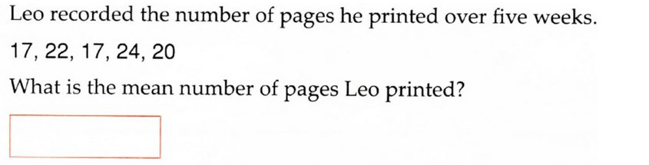
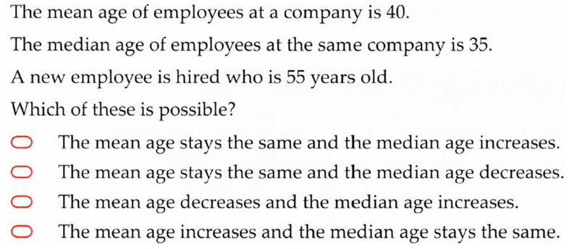
Statistics
2016
2016

Slide 5
A dot plot shows a set of data as a diagram.
15, 17, 16 , 11, 12, 13, 15, 16, 19, 13, 15
To create a dot plot, get the data in order.
11, 12, 13, 13, 15, 15, 15, 16, 16, 17, 19
Next create a line that extends from the lowest number to the highest.
For every number in the list create a dot above its number on the line
10 11 12 13 14 15 16 17 18 19

Slide 6
A dot plot shows a set of data as a diagram.
15, 17, 16 , 11, 12, 13, 15, 16, 19, 13, 15
To create a dot plot, get the data in order.
11, 12, 13, 13, 15, 15, 15, 16, 16, 17, 19
Next create a line that extends from the lowest number to the highest.
For every number in the list create a dot above its number on the line
Your turn.
Try make a dot plot with the following. 4, 6, 6, 7, 8, 9, 11
10 11 12 13 14 15 16 17 18 19

Slide 7
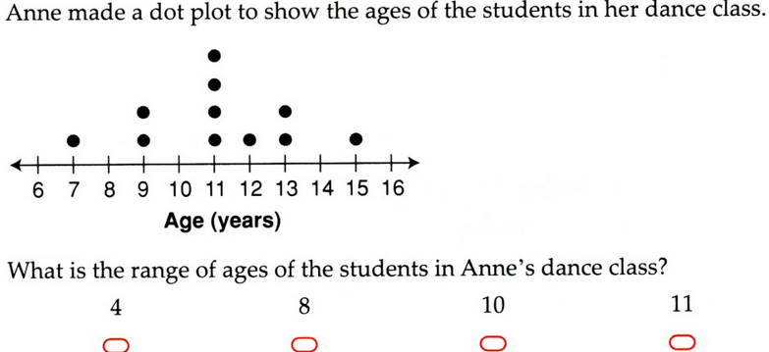
2016

Slide 8
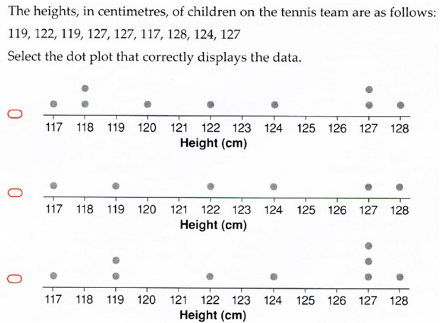
2016

Slide 9
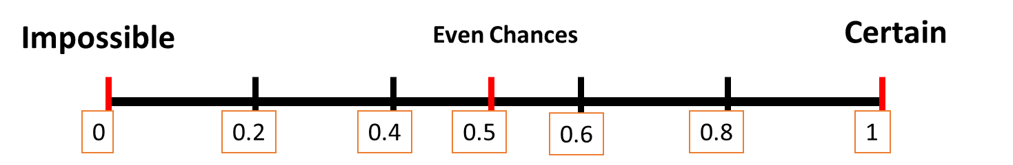


probability of an event is the chance of that event happening between 0 and 1. it can be written as words, a fraction, decimal or percentage.
A Sample Space is a complete list of all possible outcomes.
Eg tossing a coin - S = { H, T }
Theoretical probability - is determining the chance of an event occurring
Experimental probability - Is the number of times an event happens divided by the total number of trials.
$$P\left(event\right)=\frac{number of times outcome can occur}{total number of outcomes}$$
$$P\left(event\right)=\frac{number of times event occurs}{total number of trials}$$
Notes:
Check students understand the terminology used

Slide 10
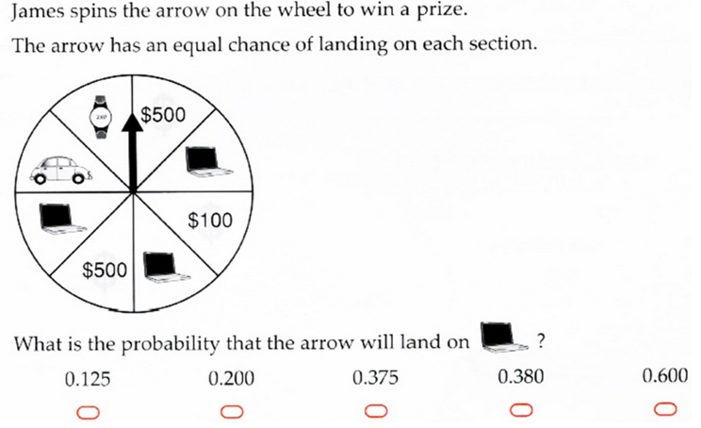
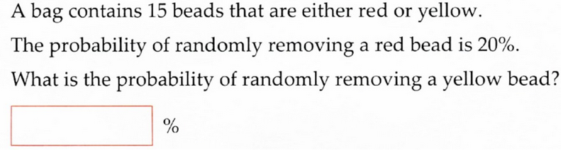
Probability
2016
2016

Slide 11
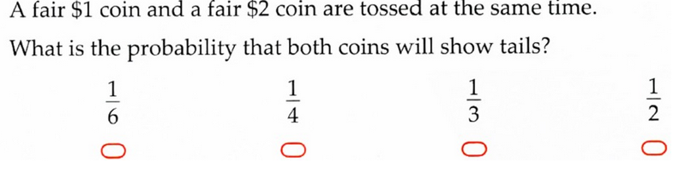
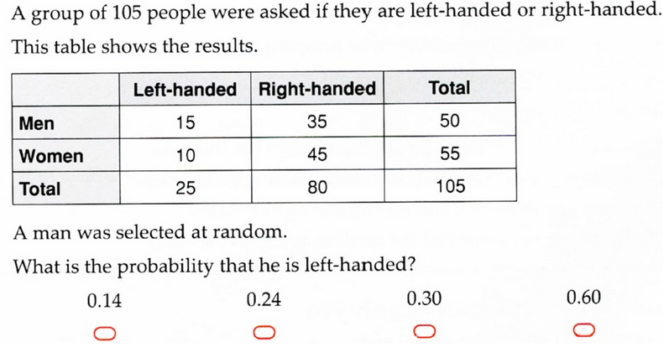
2016
2016

Slide 12
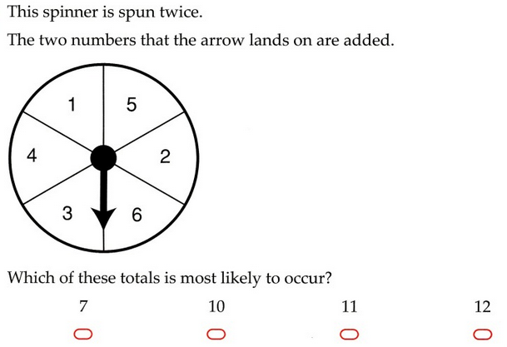
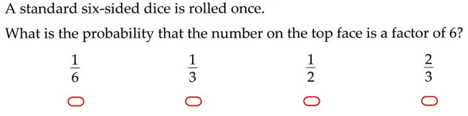
2015
2015

Slide 13
A Venn diagram is a way to represent probability data.
Eg. 50 people were surveyed on if they liked Coke or Pepsi.
Results show 24 people like only coke, 12 like only pepsi, 10 like both and 4 like neither.
Coke
Pepsi
24
10
12
4

Slide 14
How many people in the class like Pizza.
How many like McDonalds?
How many like both?
How many like neither?
Notes:
Get students to answer q’s collectively and show how to build Venn Diagram.

Slide 15
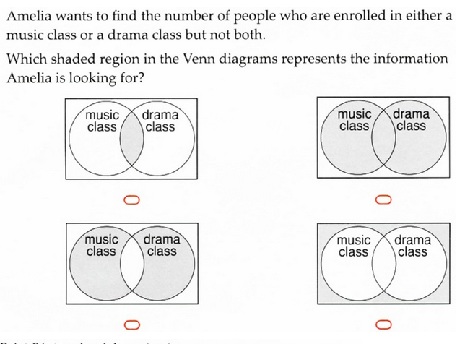
2016

Slide 16
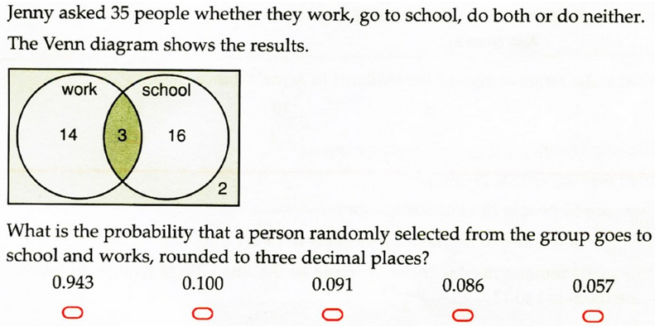
2016

Slide 17
Exit pass
On a piece of paper answer the following.
4, 6, 6, 7, 8, 12, 13
What is the mean, mode, median and range? Draw a dot plot.
What is the probability of getting a 4 on a 6 sided dice?
6 people only like running, 4 people only like swimming, 2 people like both and 5 people like neither. Draw a venn diagram for this.

